Slide 1
Content-Based Movie Recommendation System
Neshat J. Heravi
JANUARY 26, 2022 • 5:00 PM

Slide 2
The Plot
Recommendation systems improve user experience and increase revenue
Content-based recommendation systems can eliminate the “cold-start” problem
Widely used for recommending movies, articles, restaurants, places to visit, items to buy etc.
Goal
Build a content-based movie recommendation system based on movie plot overviews using Natural Language Processing.

Slide 3
Methodology
Data & Tools
45,466 movies featured in the MovieLens dataset (movies that are released on or before July 2017) on Kaggle
Python Libraries & Packages:
Pandas & Numpy
NLTK
Scikitlearn
Wordcloud
Text Preprocessing
Cleaning:
Removing duplicates & missing entries
Removing extra features
Removing short overviews
Preprocessing:
Removing proper nouns and numbers etc.
Tokenizing
Parts of speech labeling
Lemmatizing
Vectorizing (TF-IDF)
Topic Modeling & Recommendation System
Topic Modeling:
Dimensionality Reduction
Non-negative Matrix Factorization (NMF)
Recommender System:
Topic Profiles
Cosine similarity

Slide 4
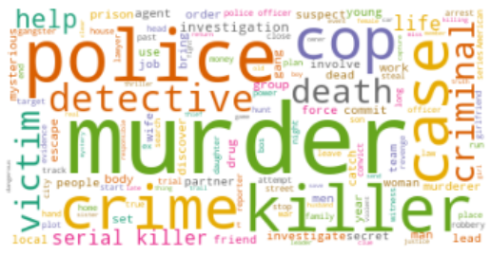
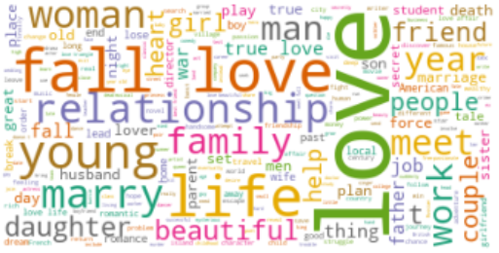
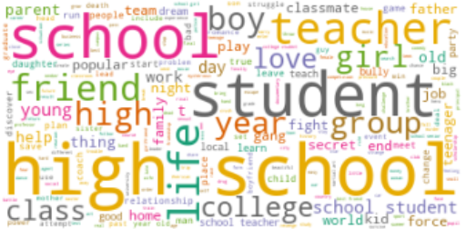
Insights
Wordcloud Text Visualization for Different Topics:
1
2
3

Slide 5
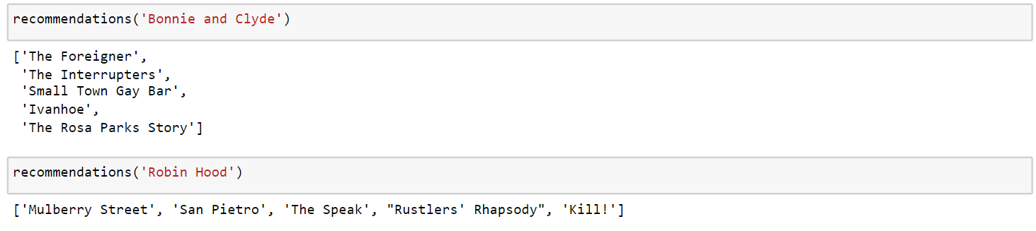
Results
Content-based Recommendation System:
Input: Movie Title
Output: 5 Movie Recommendations
Example
Input: Bonnie & Clyde
Output: [‘The Foreigner’, ‘The Interrupters’, ‘Small Town Gay Bar’, ‘Ivanhoe’, ‘The Rosa Park Story’]
Content Theme: Resistance , Rule-breaking & Interruption

Slide 6
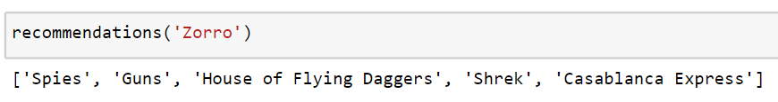
Conclusion & Future Works
The created recommendation system is based on movie overview plot contents.
It takes in a movie title and will suggest 5 other movies
As Is: ‘Zorro’ and ‘Shrek’ have similar plots! They really do!!
How to Improve the System?
By adding filters such as movie origins, genre, release date etc.

Slide 7
Thank You!

